Slide 1
Association rule mining
Pea LAB
Bang jeho, Lee jiwon
2019.05.13

Slide 2
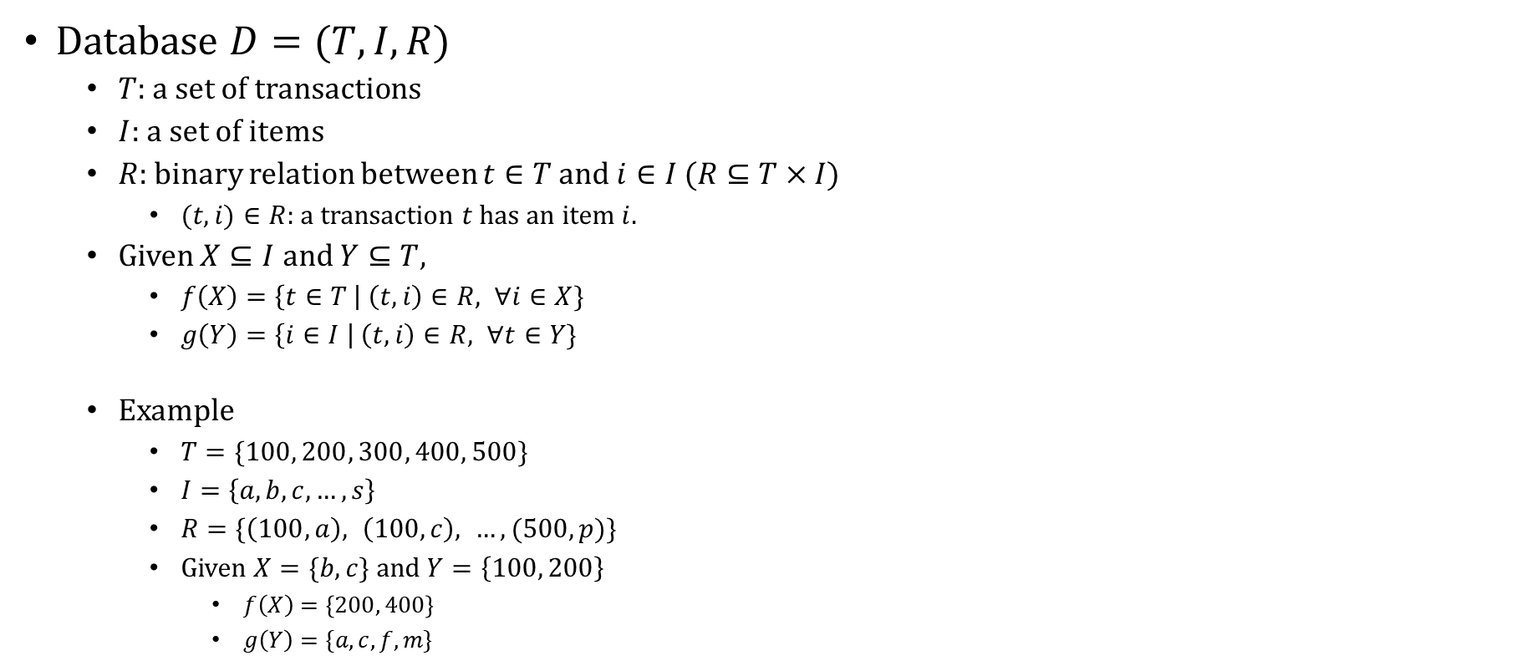
Association Relation Mining
Database $D=(T, I, R)$
$T$: a set of transactions
$I$: a set of items
$R$: binary relation between $t∈T$ and $i∈I$ $(R⊆T×I)$
$(t, i)∈R$: a transaction $t$ has an item $i$.
Given $X⊆I$ and $Y⊆T$,
$f\left(X\right)=\left\{t∈T \right| \left(t, i\right)∈R, ∀i∈X\}$
$g\left(Y\right)=\left\{i∈I \right| \left(t, i\right)∈R, ∀t∈Y\}$
Example
$T=\{100, 200, 300, 400, 500\}$
$I=\left\{a, b, c, …, s\right\}$
$R=\{\left(100, a\right), \left(100, c\right), …, (500, p)\}$
Given $X=\{b, c\}$ and $Y=\left\{100, 200\right\}$
$f\left(X\right)=\left\{200, 400\right\}$
$g\left(Y\right)=\{a, c, f, m\}$

Slide 3
We use HashMap
Key
“a” | “b” | “c”
100
200
300
200
300
400
100
200
400
500
Value

Slide 4
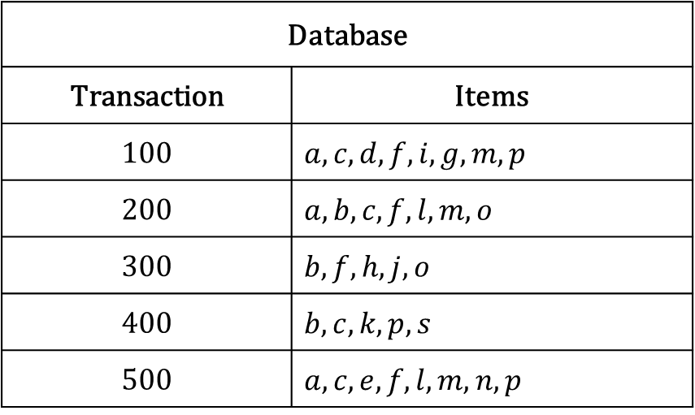
Association Relation Mining
Database
Transaction | Items
100 | $a, c, d, f, i, g, m, p$
200 | $a, b, c, f, l, m, o$
300 | $b, f, h, j, o$
400 | $b, c, k, p, s$
500 | $a, c, e, f, l, m, n, p$

Slide 5
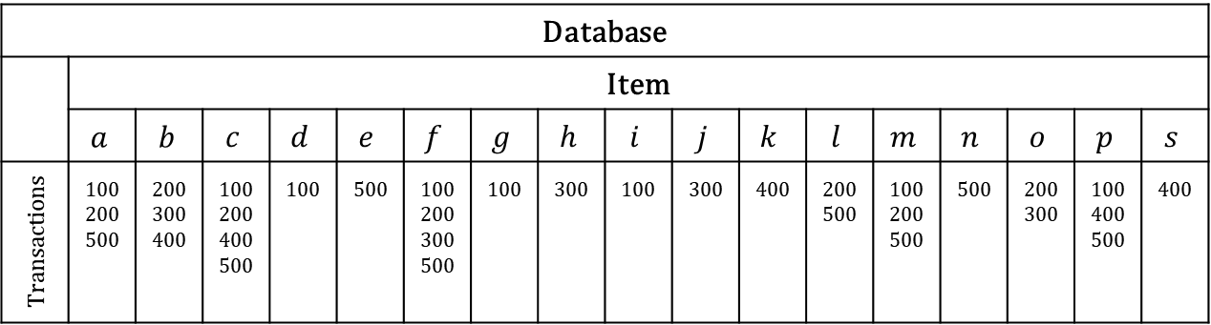
Java HashMap<Key, Value>
Database
 | Item
 | $$a$$ | $$b$$ | $$c$$ | $$d$$ | $$e$$ | $$f$$ | $$g$$ | $$h$$ | $$i$$ | $$j$$ | $$k$$ | $$l$$ | $$m$$ | $$n$$ | $$o$$ | $$p$$ | $$s$$
Transactions | ₁₀₀ ₂₀₀ ₅₀₀ | ₂₀₀ ₃₀₀ ₄₀₀ | ₁₀₀ ₂₀₀ ₄₀₀ ₅₀₀ | ₁₀₀ | ₅₀₀ | ₁₀₀ ₂₀₀ ₃₀₀ ₅₀₀ | ₁₀₀ | ₃₀₀ | ₁₀₀ | ₃₀₀ | ₄₀₀ | ₂₀₀ ₅₀₀ | ₁₀₀ ₂₀₀ ₅₀₀ | ₅₀₀ | ₂₀₀ ₃₀₀ | ₁₀₀ ₄₀₀ ₅₀₀ | ₄₀₀
Key
Value

Slide 6
Intersection with Item a and Item b
HashMap
Key
“a” | “b” | “c”
Array List
“a”
“b”
“c”
100 | 200 | 300
200 | 300 | 400
100
200
300
200
300
400
100
200
400
500
Value
100 | 200 | 400 | 500

Slide 7
Intersection with Item a and Item b
Array List
Array List
“a”
“b”
“c”
100 | 200 | 300
A and B
200 | 300
200 | 300 | 400
A and C
100 | 200
100 | 200 | 400 | 500
B and C
200 | 400

Slide 8
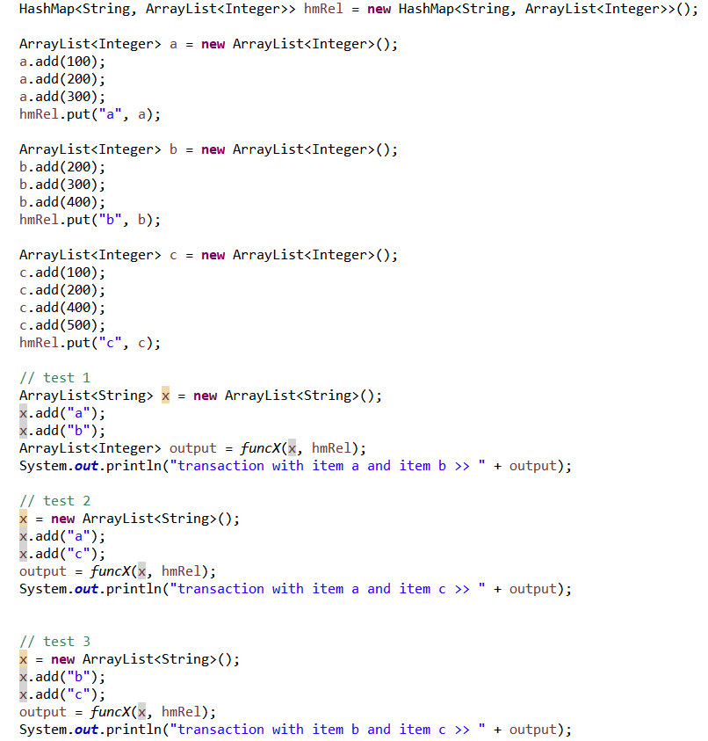
Java Code

Slide 9
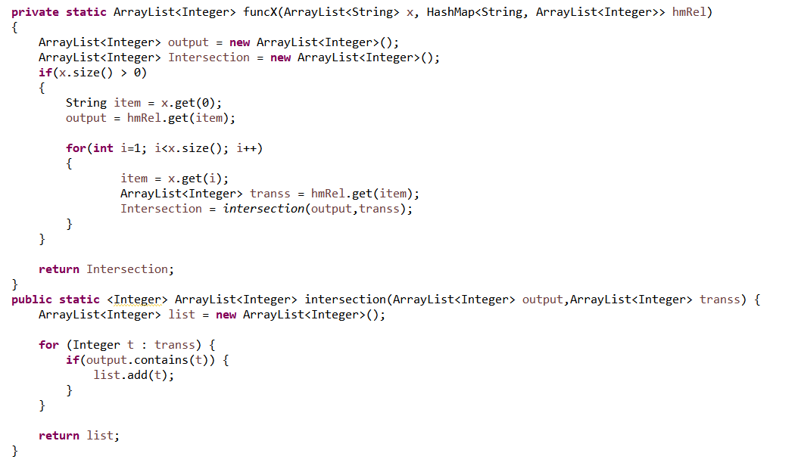
Java Code

Slide 10
Thank you
Association Relation Mining
Pea LAB
2019.05.13

